Slide 1
High Uniformity Hot Plate for Wafer Processing
Hot Plate Design Report |Dhruv Rao, 26B1818

Slide 2
Specifications
Requirement | Target
Wafer size | >= 4 inches (100 mm) usable zone
Temperature range | Room temp to 400 C
Accuracy(Run to Run repeatability) | < 5 C
Deviation ( Uniformity) | < 0.5 C
Top surface flatness | ≤10 um

Slide 3
Concept
Since the wafer proposed is 100 mm in measure, a 150mm hotplate will be used. Wafer area on hotplate broken into a grid of 25 intersecting current carrying channels using both a pcb board providing each cartridge heater with its own PWM signal input and 24V supply lines with GND cables(More on this in Slide 4). A thermal imaging camera capable of measuring temperature variance of 40-50mK is constantly taking framed pictures of hotplate once it reaches steady state of 400 C and is transmitting data to PID controller which translates the images into a temperature grid thus letting it know which heaters to crank up to maintain temperature throughout wafer . This reduces thermal gradient and prevents thermal stress in wafer during baking process. It does this by sending different pwm outputs through 2 16-channel PWM drivers to the cartridge heater/s at the target areas and using MOSFETs as the switches and current amplifiers for each heater. Since the plate is chosen to be of greater area, edge heat runoff is not a big concern of ours. The PID controller will ensure minimum deviation in temperature throughout wafer surface and will also ensure translation of temperature variation data retrieved from thermal camera.

Slide 4
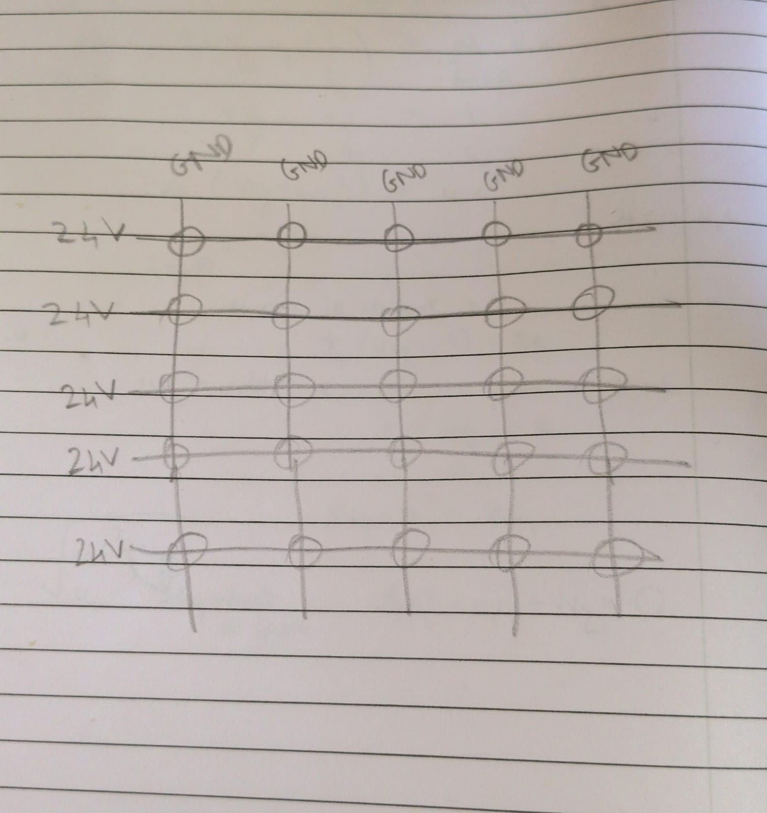
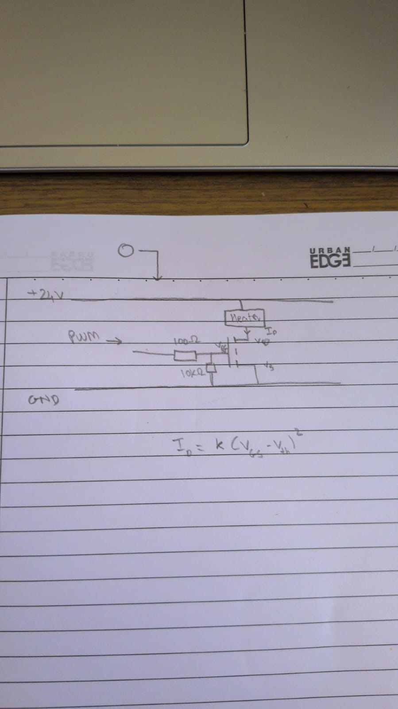
Circuit Work
So it will be 5 parallel wires running horizontally each providing +24 Vc to the mosfet and thus the heater and 5 vertically for the ground. The 25 separate PWM inputs for each base of the mosfet will be drawn from 1 of 2 16-channel PWM drivers through soldering on a PCB board. The circuit diagram is shown below.

Slide 5
Thermal Design
Plate material: (Aluminium); Plate side length(150mm); Thickness(25mm)
Heater type and layout: (cartridge, multi-zone)
25 Cartridge heaters in 5x5 grid
Power = mass x specific heat x dT / ramp time + losses leads to about 40 W per heater
Uniformity analysis: Using thermal camera during baking.

Slide 6
Electrical and Control Design
Circuit: Thermal Camera (more cost efficient), 25 heaters and fiberglass cables
Controller: Self made with raspberry pi zero 2W
Power stage and safety: SSR switch, fuse, independent over-temperature cutoff, earthing, enclosure.

Slide 7
Mechanical Design
CAD views: isometric
Plate grooves and ridges for cartridge heaters
Wafer location features, cable routing, enclosure
Engineering drawing of the plate with dimensions and tolerances

Slide 8
Flatness (+/- 10 um)
Making an extremely flat aluminium plate is tedious and requires technology which isn’t available in the fab
I would buy the Mic-6 aluminium plate from IndiaMart. A local supplier is crucial and India mart supplies for 500Rs./kg
This plate is made with very tight tolerances which lie within our 10 micrometre threshold and will be used for our hotplate.

Slide 9
Run to Run Repeatability
Install 2 PT100s sensors (rated for 450 C) on the plate. These sensors have a resistance inside them which change with change in temperature thus enabling us to get absolute readings of temperature.
Relay this information back to the raspberry pi to properly fix the start point for the run.
Container in which baking occurs should also be maintained at a fixed temperature so as to regulate temperature deviation in hotplate even before the run starts.

Slide 10
Bill of Materials
Item | Specification | Qty | Cost (INR) | Source
Plate | MIC 6 Aluminium Plate | 1 | <5k (500/kg) | IndiaMart
Heater | Cartridge Heaters (100W) | 25 | <15k | IndiaMart
Temperature sensor | Thermal camera | 1 | ~20k | Amazon
Controller | PID algorithm controller | 1 | <1.5k(raspberry pi zero 2W) | Made in fab
SSR / power switch | 50 Ampere power switch | 1 | ~1.2k | IndiaMart
MOSFETS, heat sinks | Standard issue mosfets | 25 | ~5k
Insulation + wiring(high heat) | Calcium silicate + FibreGlass cables | 1 | ~1k | IndiaMart
PT 100s | Heat sensors for accurate temperature measurement | 2 | ~2-4k
24V power supply | 24 volt supply for 25 heaters | 1 | ~10k
PWM driver boards | 16-channel pwm driver boards () | 2 | ~500-1k
Total |  |  | ~62k | ME 😐 (i can do math)

Slide 11
Assembly Instructions
Prepare and inspect the plate (flatness, hole positions)
Install heater(s) and sensor(s)
Mount plate on thermal-isolation standoffs, fit insulation
Wire power stage and safety cutoffs; connect controller and camera
First power-up checks, then calibration and tuning

Slide 12
Risks, Conclusion and References
Risks and limitations: oxidation, warping at 400 C
Camera catches noise which has nothing to do with the wafer
The design fulfills the 0.5C I checked by running a simulation on a standard LLM (Claude and chatgpt both)
References: LLMs, Wikipedia, Youtube, IndiaMart, allaboutcircuits

